Slide 1
Business Analyst Career Program – Internship Project By Camellia Pramanik (Batch 3)

Slide 2
Project analysis slide 2
Project Analysis
Endnotes
Import the data into Power BI
AGENDA
Conclusion and Inferences
Explaining insights from Plot/Graph plotted
Interactive Dashboard by using Power BI
Data Analysis of the Plot/Graph plotted

Slide 3
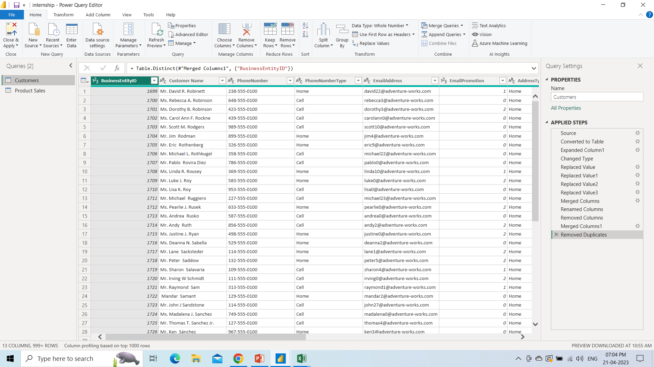
Project analysis slide 2
Import the data into Power BI
Import of the data and Data Cleaning and other possible operations on data using query editor (FIRST DATA SET)

Slide 4
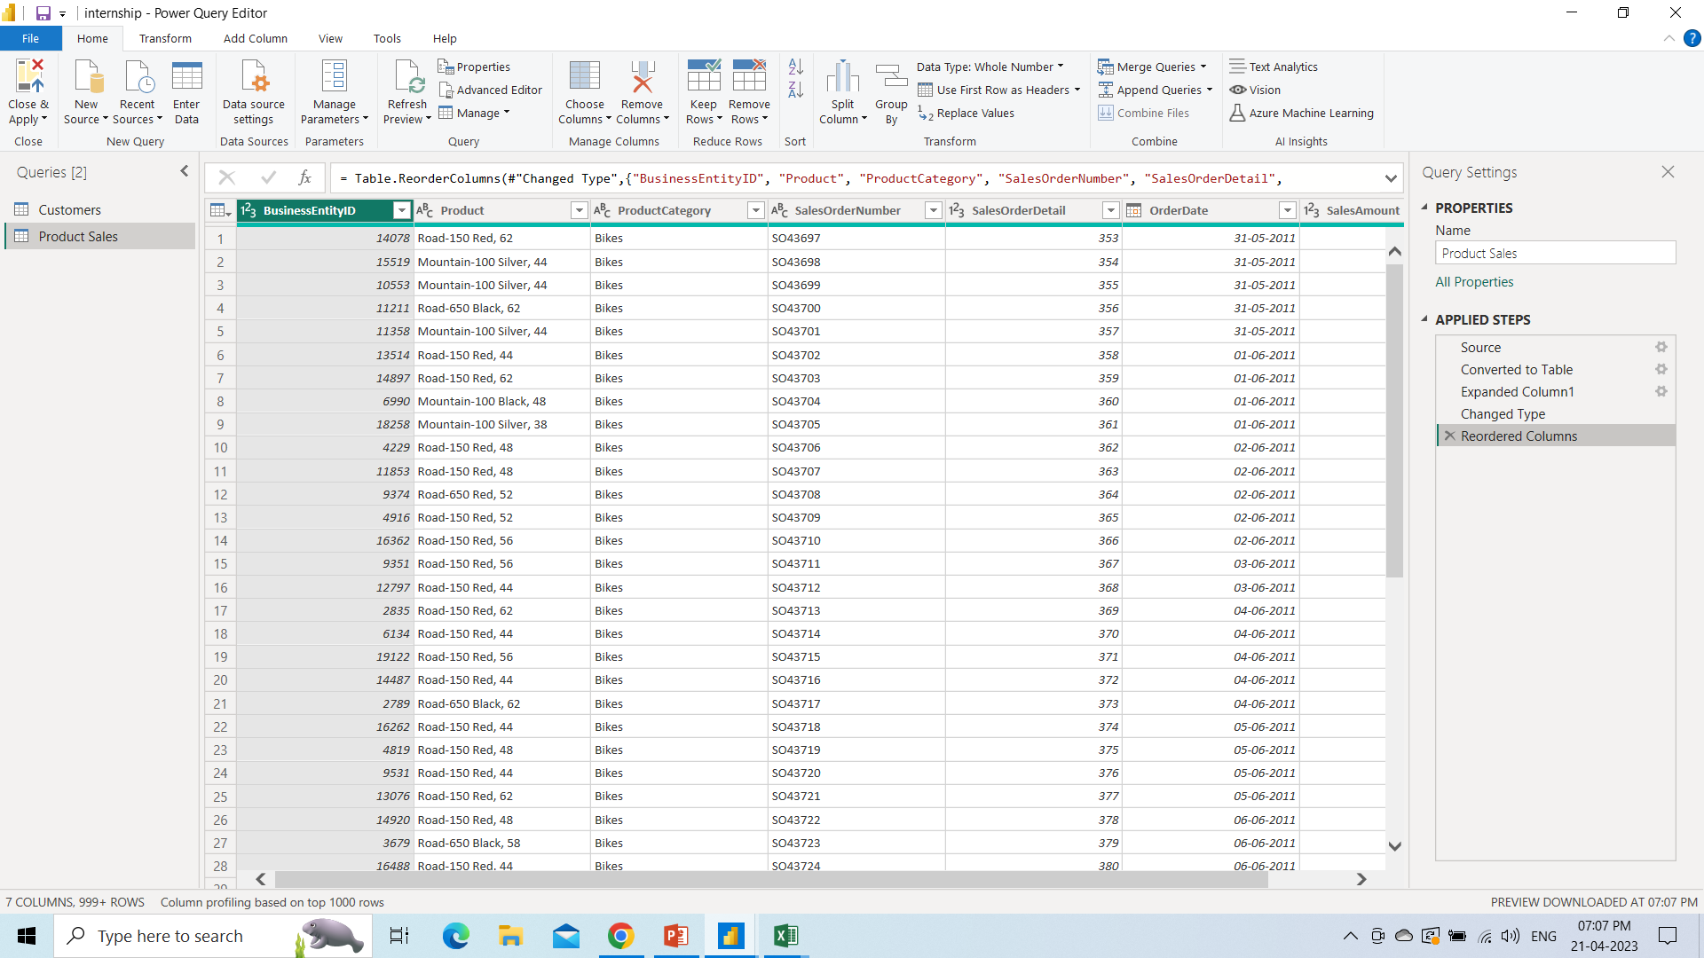
Project analysis slide 2
Import the data into Power BI
Import of data and Data Cleaning and other possible operations on data using query editor (SECOND DATA SET)

Slide 5
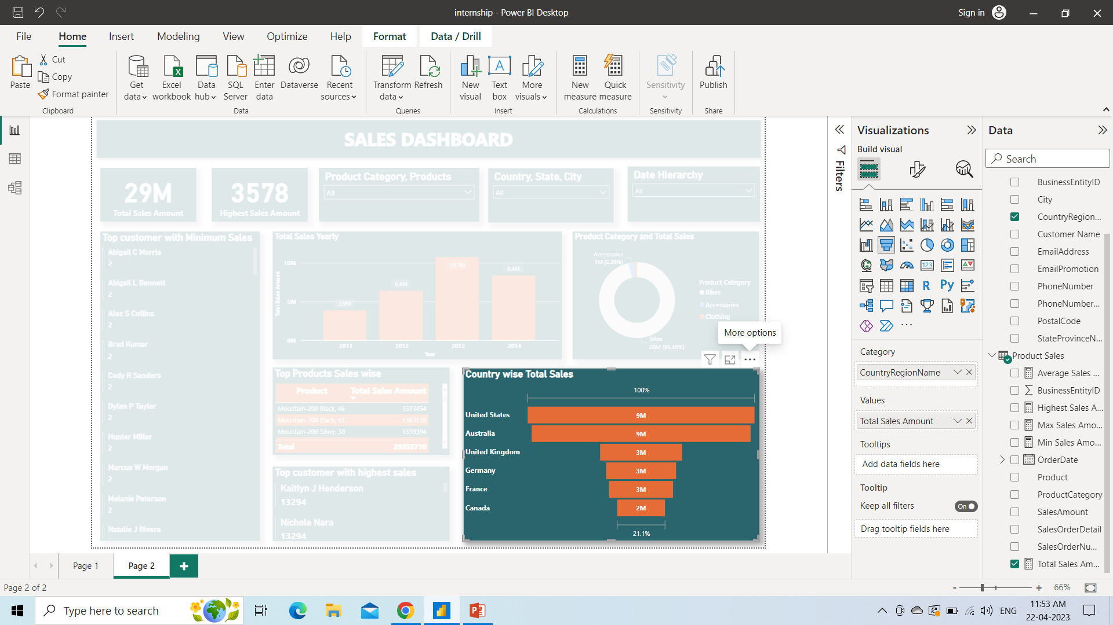
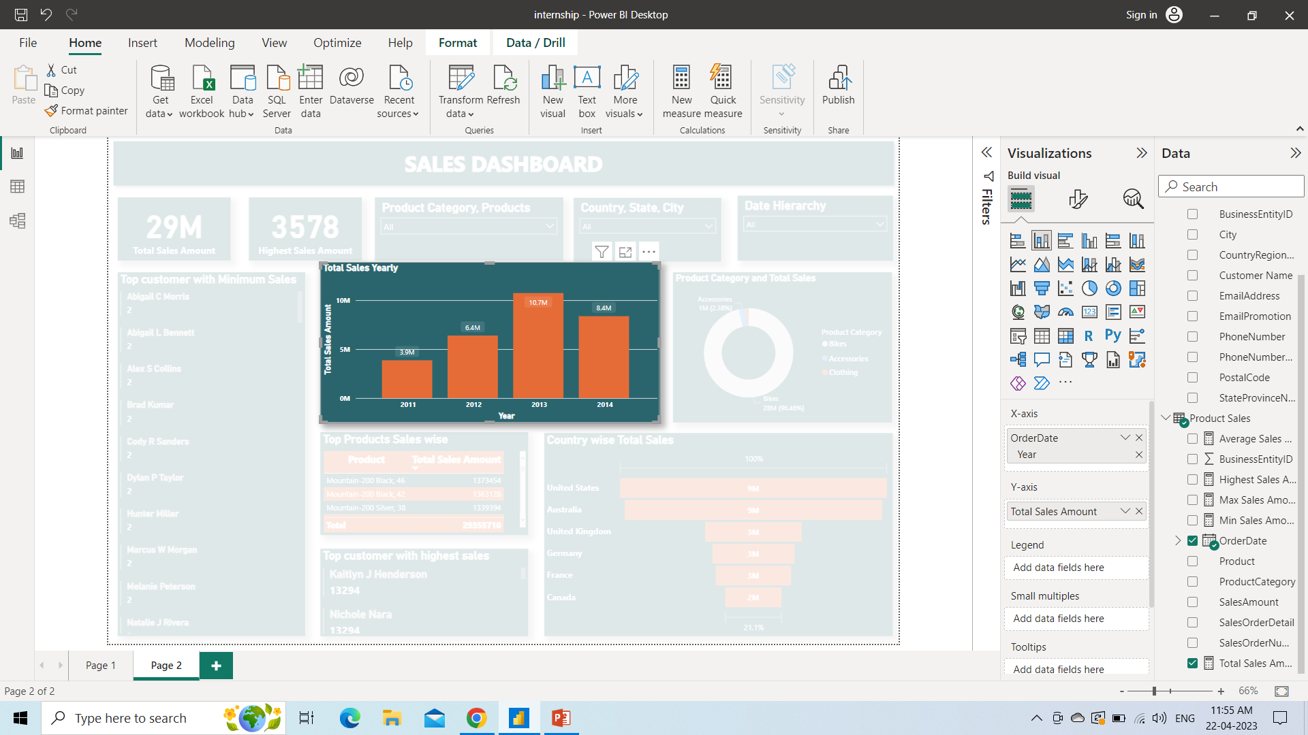
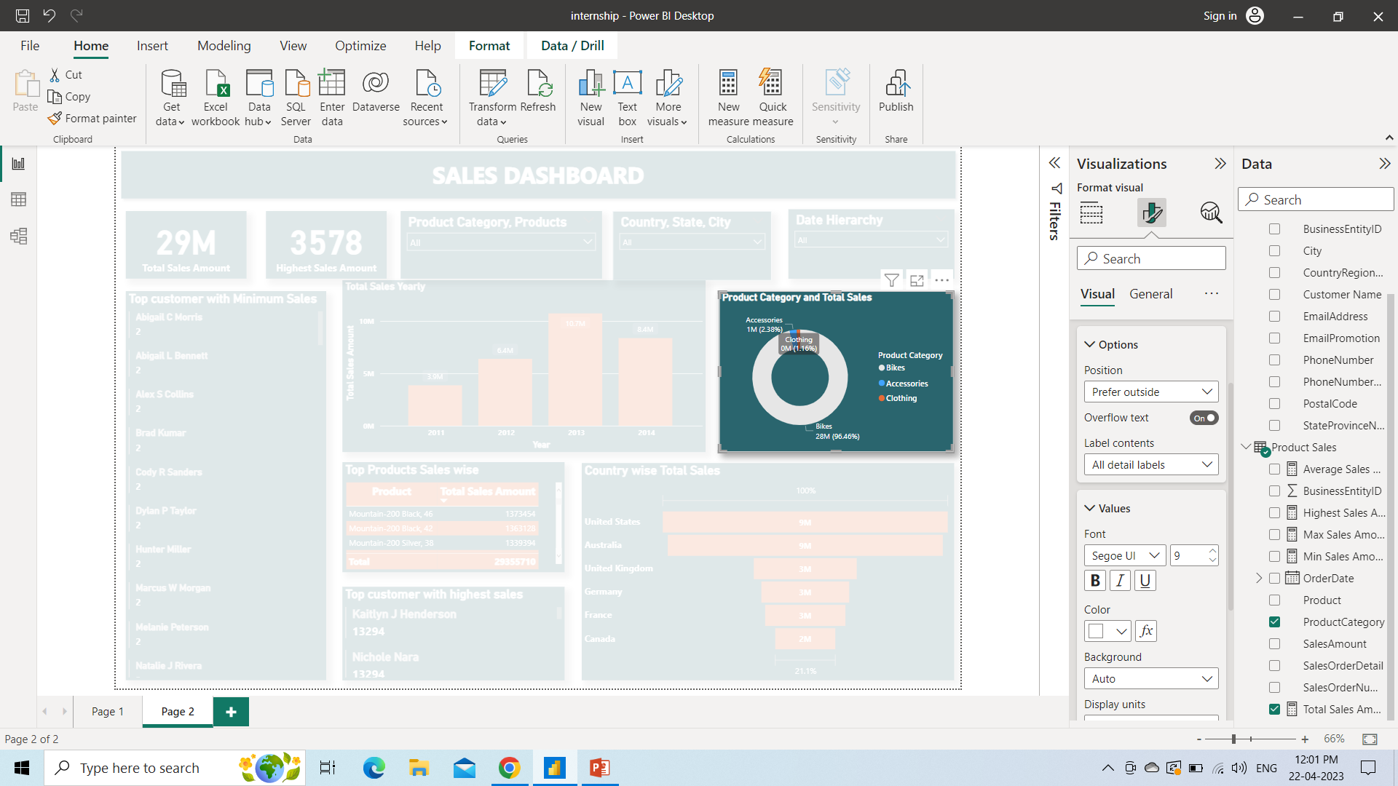
Project analysis slide 5
Insights From Plot/Graph Plotted
1. Yearly Total Sales
2. Product Category Sales
3. Country wise Sales
Total sales overall is 29M however in the year 2013, Sales is the highest of value 10.7M. While, year 2011 have the minimum sales.
In the product category, Bikes have the highest sales of almost 96.46% of the total sales while Clothing have the minimum sales of only 1.16%.
Among all the countries, United States, have the highest sales while Canada have the minimum sales.

Slide 6
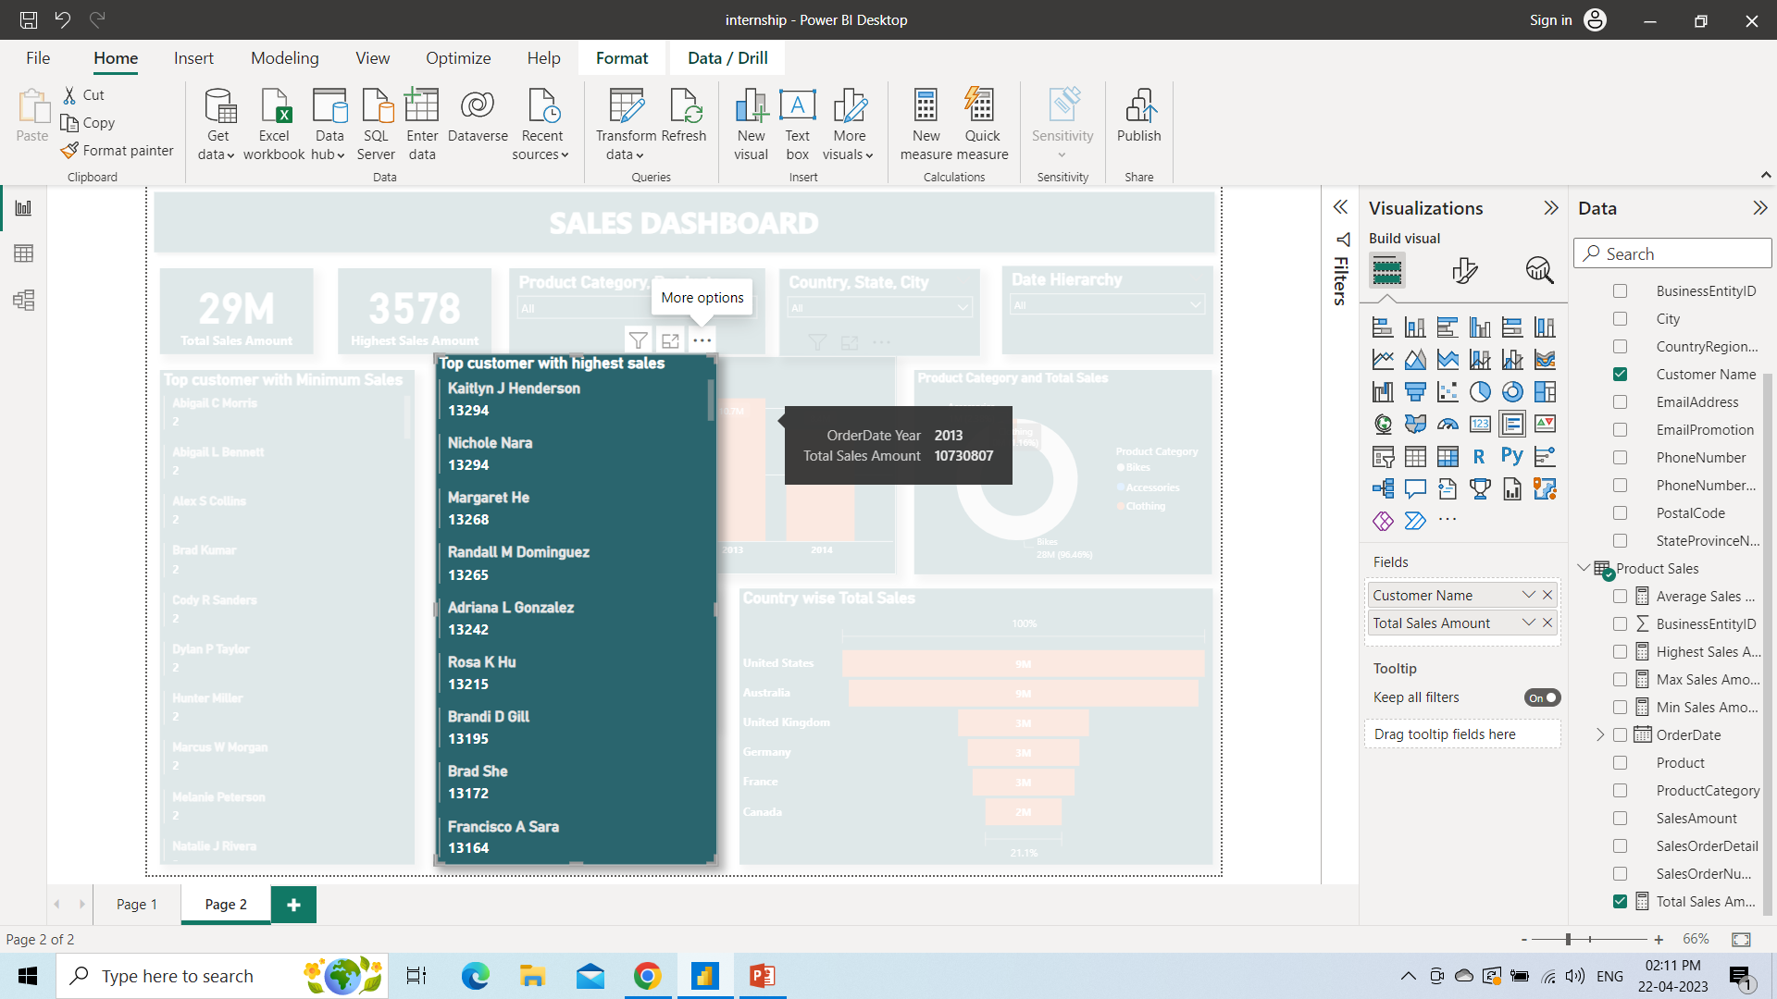
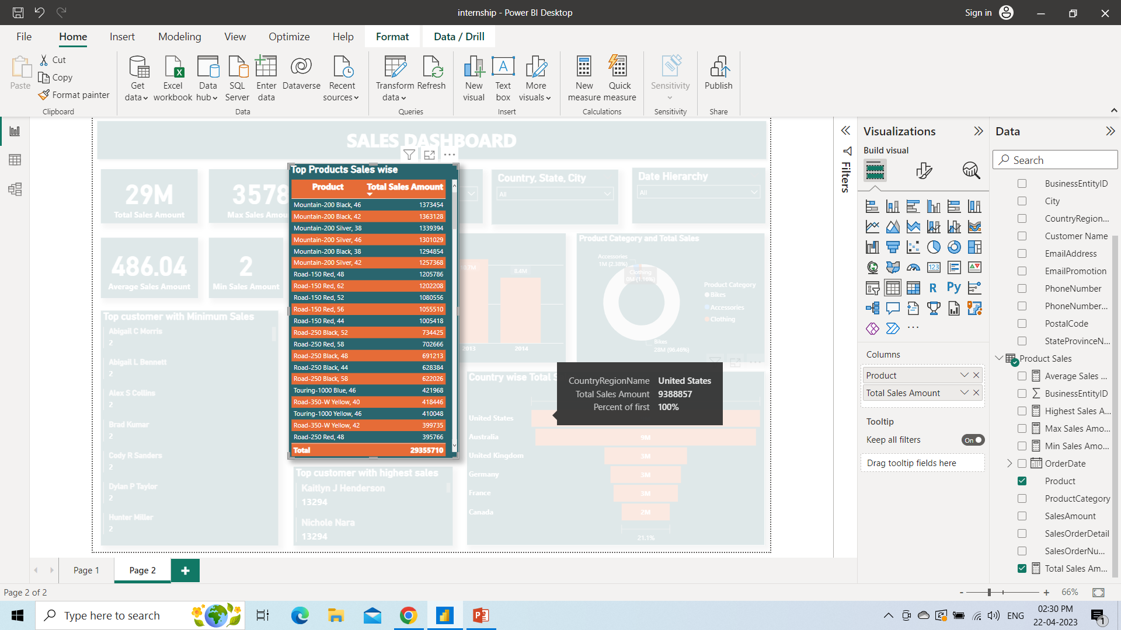
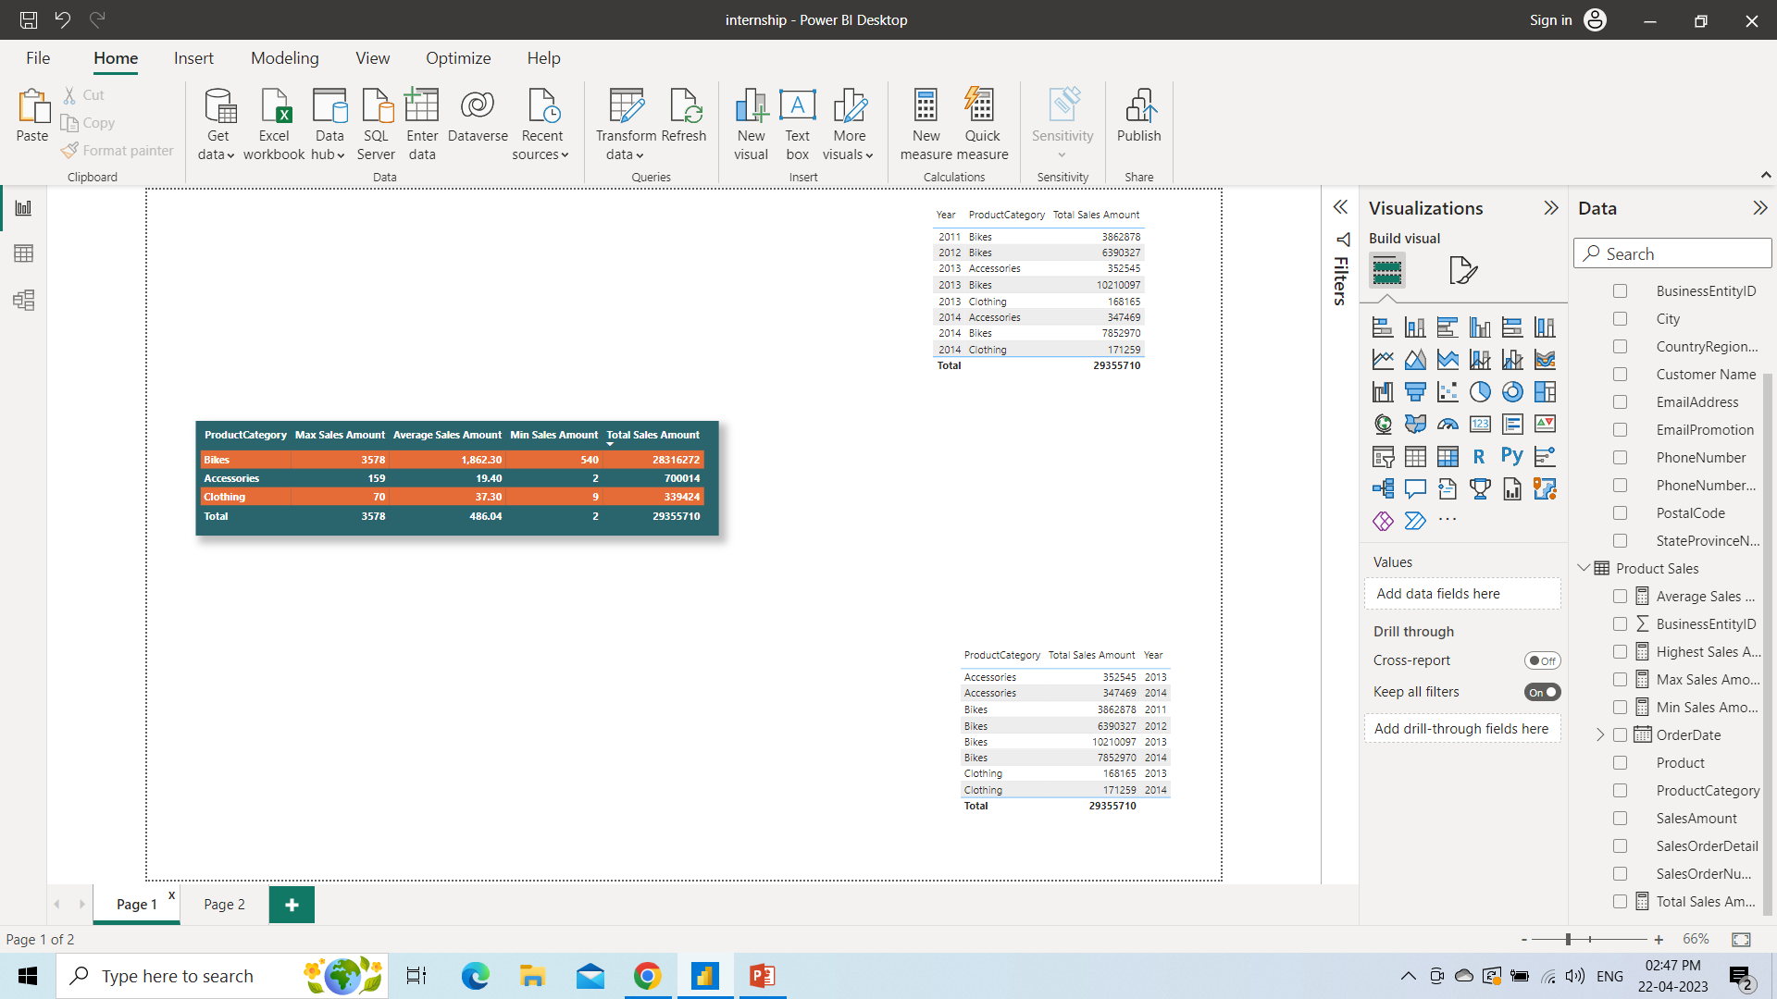
Project analysis slide 5
Insights From Plot/Graph Plotted
4. Customers from highest to lowest Sales
5. Products from highest to lowest Sales
6. Product Category wise Sales calculation
In descending order the names of customers with highest sales being on top the minimum sales being on the bottom, we can find customer sales overall.
In the descending order the names of products with highest sales being on top and minimum sales being on the bottom, we can find product sales overall.
Among all the product category, we can get to know the max, min, average and total sales which will help us to understand the categories defined.

Slide 7
Project analysis slide 3
Data Analysis of the Plot/Graph plotted
ANALYSIS 1
ANALYSIS 2
ANALYSIS 3
ANALYSIS 4
ANALYSIS 5
ANALYSIS 6
Product Category sales shows us which category have the highest and minimum sales and we can derive insights from that and can formulate strategy on that basis. Which product category needs more growth, it can be seen from this graph.
Country wise sales shows us the regions where the business is growing. Also we can get the idea of the region having max sales and min sales. We can easily understand which areas we need to grow. We can even see states/province sales or city sales to get a wider picture.
Customer lists created in descending order from top to bottom as top being the highest and bottom being the lowest. We can understand customers and the sales they are providing and will give insights of customers for the business.
Products lists created in descending order from top to bottom as top being the highest and bottom being the lowest. We can understand which products is highly demanded by customers and which are least demanded. Therefore, we can improvise and it gives detailed insights of the products as per sales is concerned.
Detailed sales calculations such as min, max, average and total sales as per product category helps us to understand the categories in details. Also we can understand which category is highly demanded and we need to focus and improve the sales by getting the idea from these sales measures.
Yearly total sales shows us the growth of the business overall. Also we can see quarterly or monthly sales to do the analysis of how the business is growing in a year and we can formulate strategy on that basis.

Slide 8
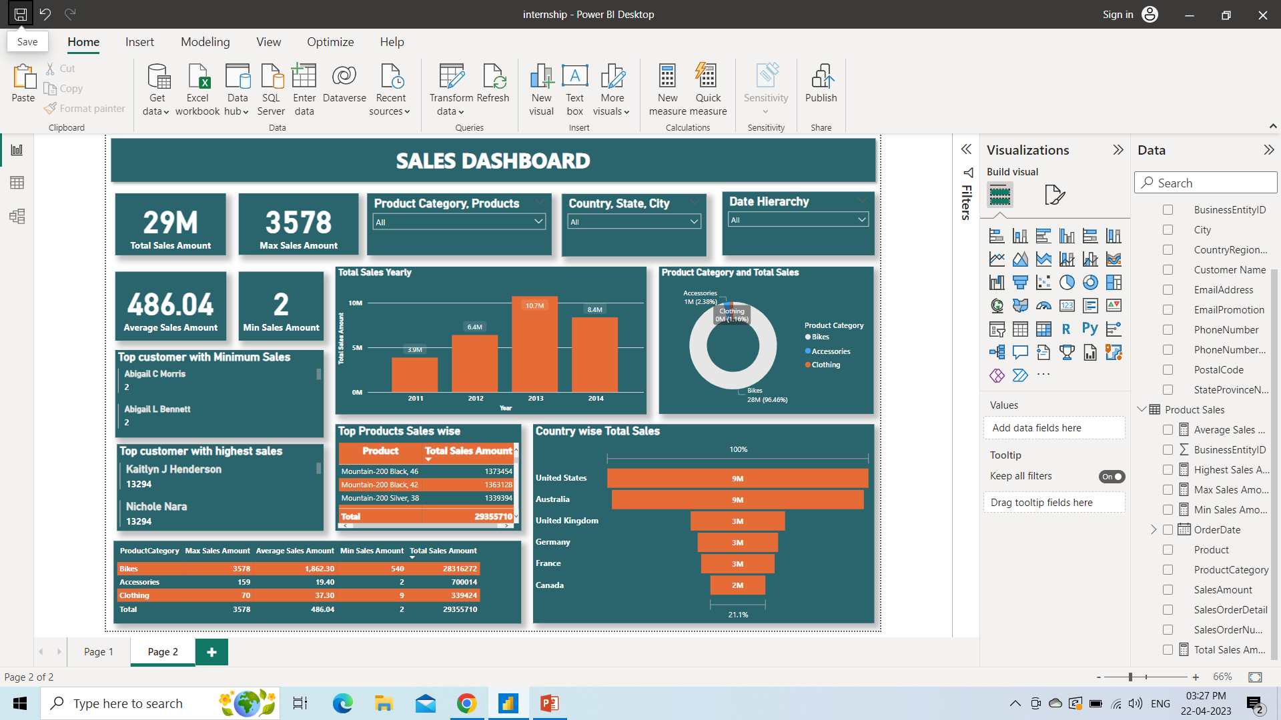
Project analysis slide 7
Interactive Dashboard by using Power BI

Slide 9
Project analysis slide 10
Conclusion and Inferences
Total Sales Amount is $29M.
Year 2013 have the highest sales of $10.7M.
Year 2011 have the lowest sales of $3.9M.
The Maximum Sales Amount is $3578.
The Minimum Sales Amount is $2.
The Average Sales Amount is $486.04.
In Product Category, Bikes have the highest sales while Clothing have the minimum sales.
Country wise, Unites States have the highest sales overall whereas Canada have the minimum sales.
Products wise Mountain – 200 Black 6 have the highest sales among all the products while Racing Socks, L have the minimum sales.
Customer wise Kaitlyn J Henderson and Nichole Nara both have the highest sales of $13,294 whereas, 11 customers including Abigail C Morris, Abigail L Bennett, Alex S Collins, Brad Kumar etc. have the minimum sales of $2.
Overall Bikes sales have been increased majorly and have the highest sales however, Accessories sales have been decreased little bit while Clothing sales have been increased.

Slide 10
Project analysis slide 8
Endnotes
Business Analyst Internship Project By Camellia Pramanik.pbix
Business Analyst Career Program – Internship Project.pptx
All the solutions of the questions are presented in this presentation post the end notes along with the relevant screenshots.

Slide 11
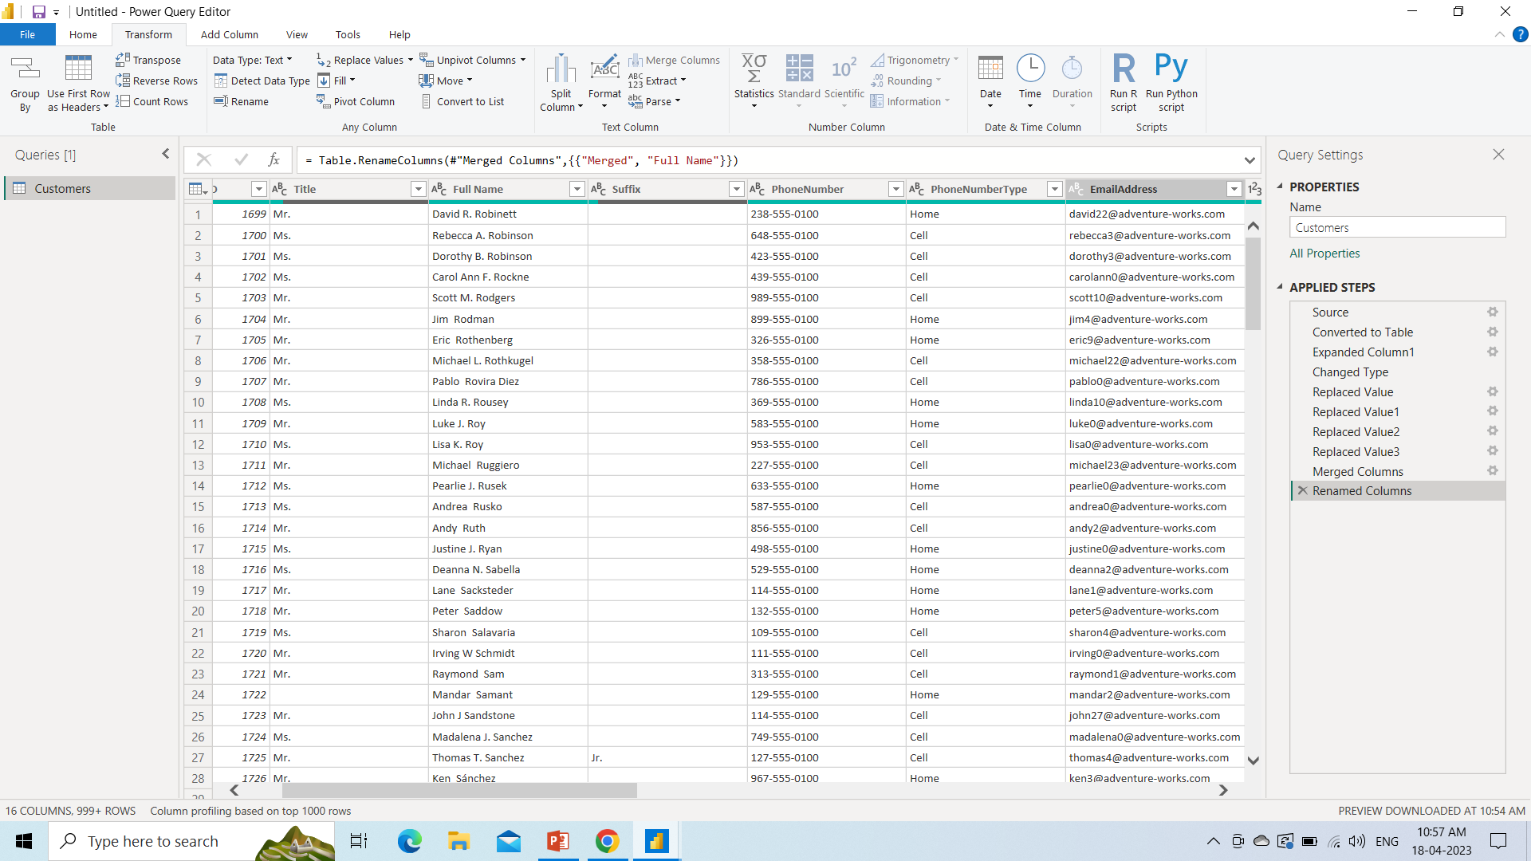
1. Transform customers data so that First Name, Middle Name and Last Name are merged into full name

Slide 12
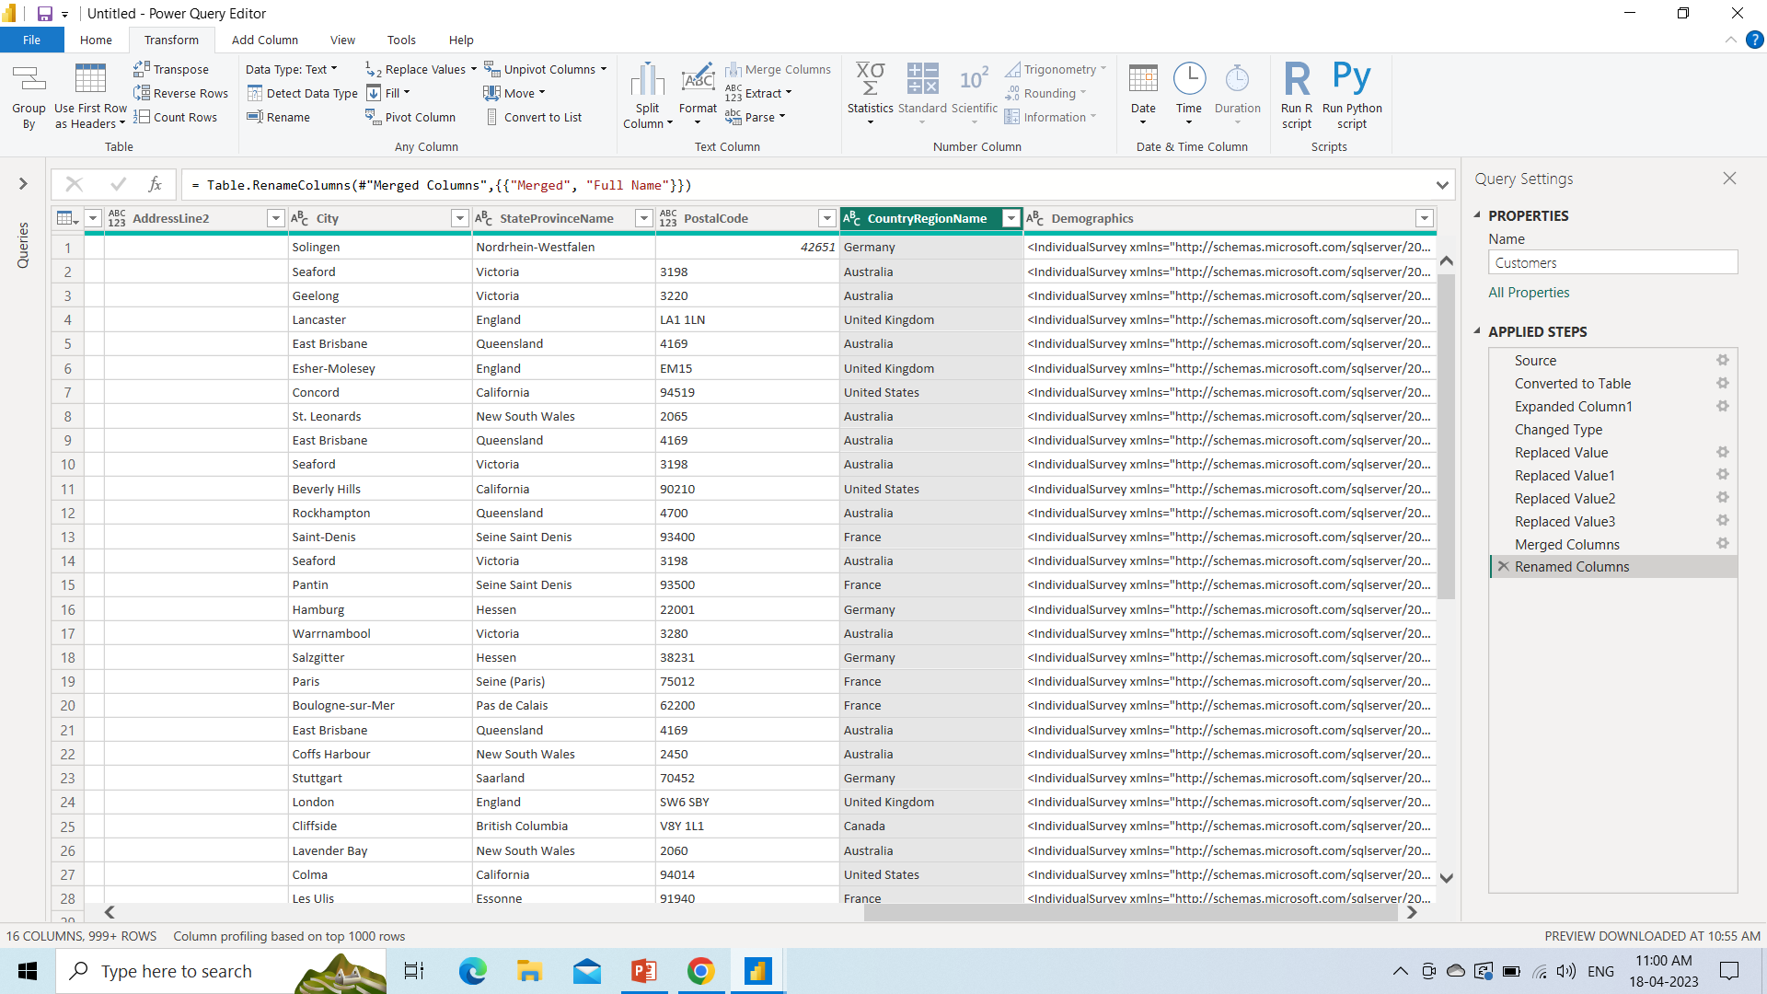
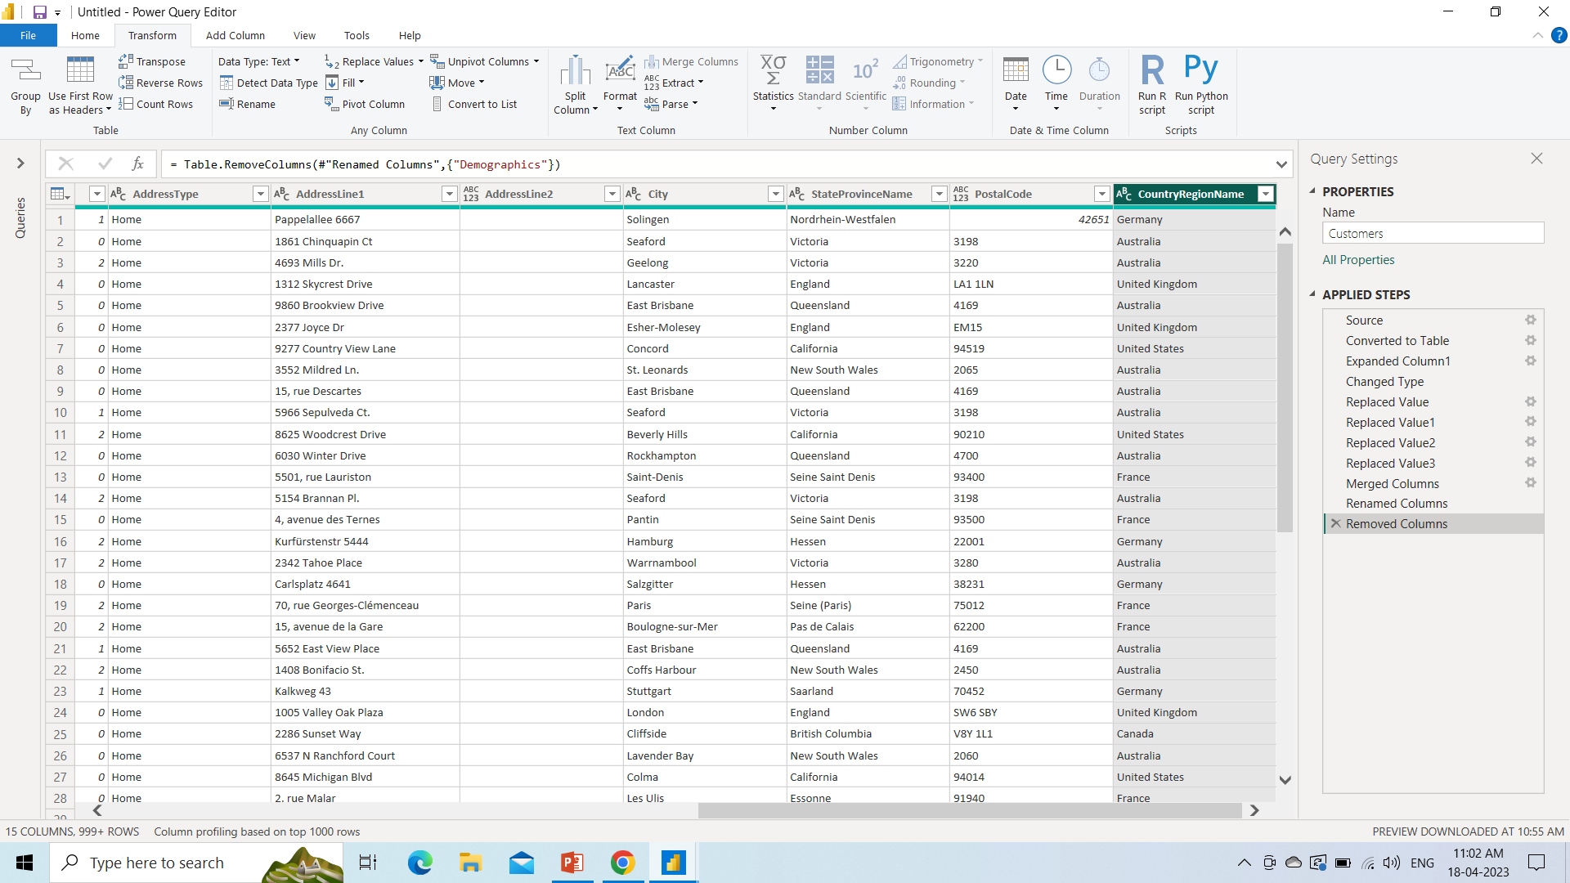
2. Demographics column is being removed
BEFORE
AFTER

Slide 13
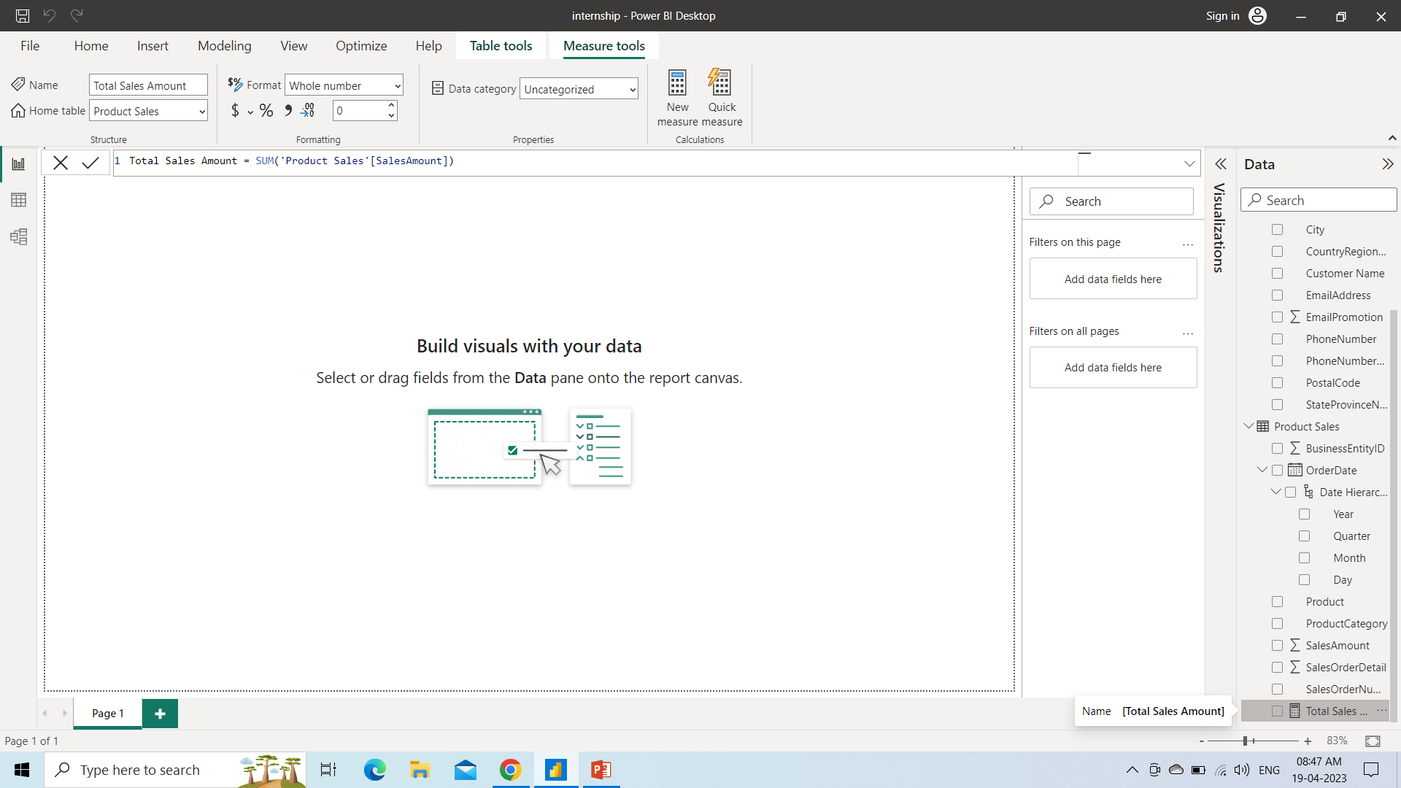
3. Create measures like Total Sales Amount.

Slide 14
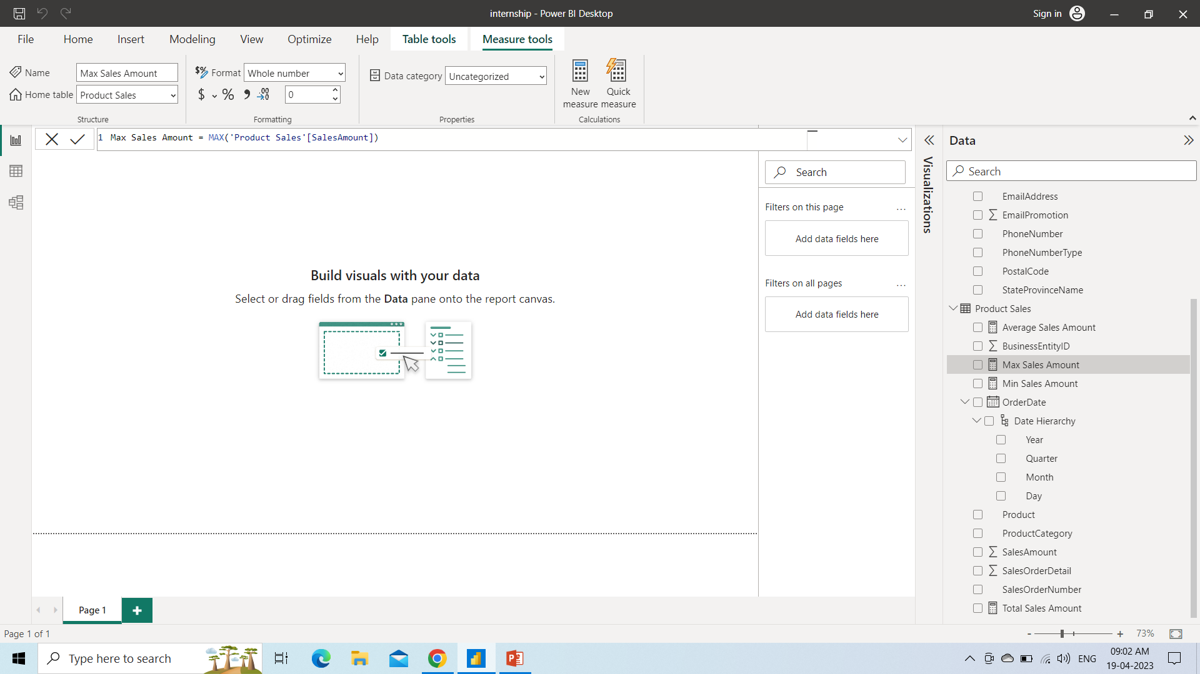
4. Create measures like Average, Min, Max Total Sales Amount.

Slide 15
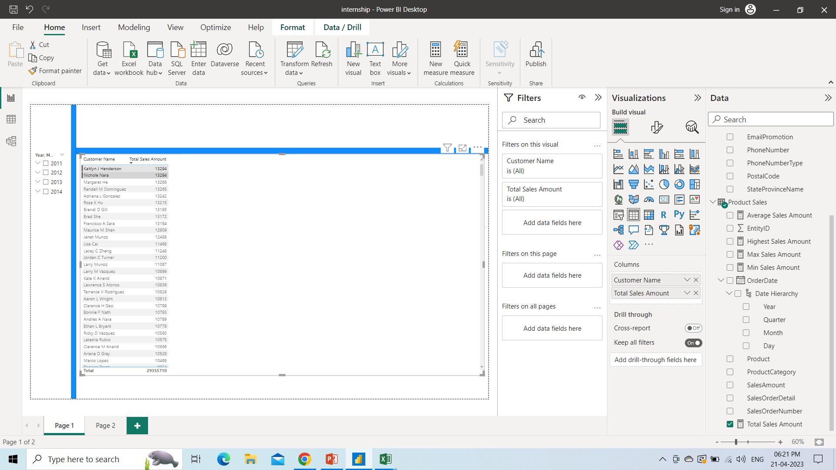
5. Which customer has the highest sales amount?
Two customers named Kaitlyn J Henderson and Nichole Nara has the highest sales amount.

Slide 16
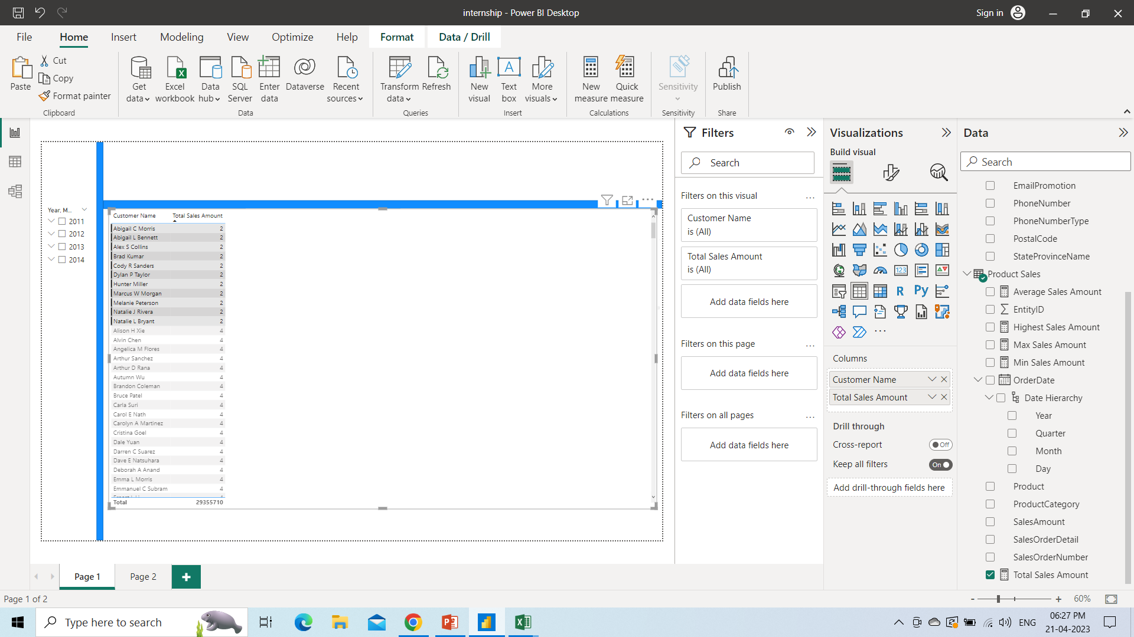
6. Which customer has the minimum sales amount?
Eleven customers named Abigail C Morris, Abigail L Bennett, Alex S Collins, Brad Kumar, Cody R Sanders, etc has the minimum sales amount. All customers names highlighted has the minimum sales amount.

Slide 17
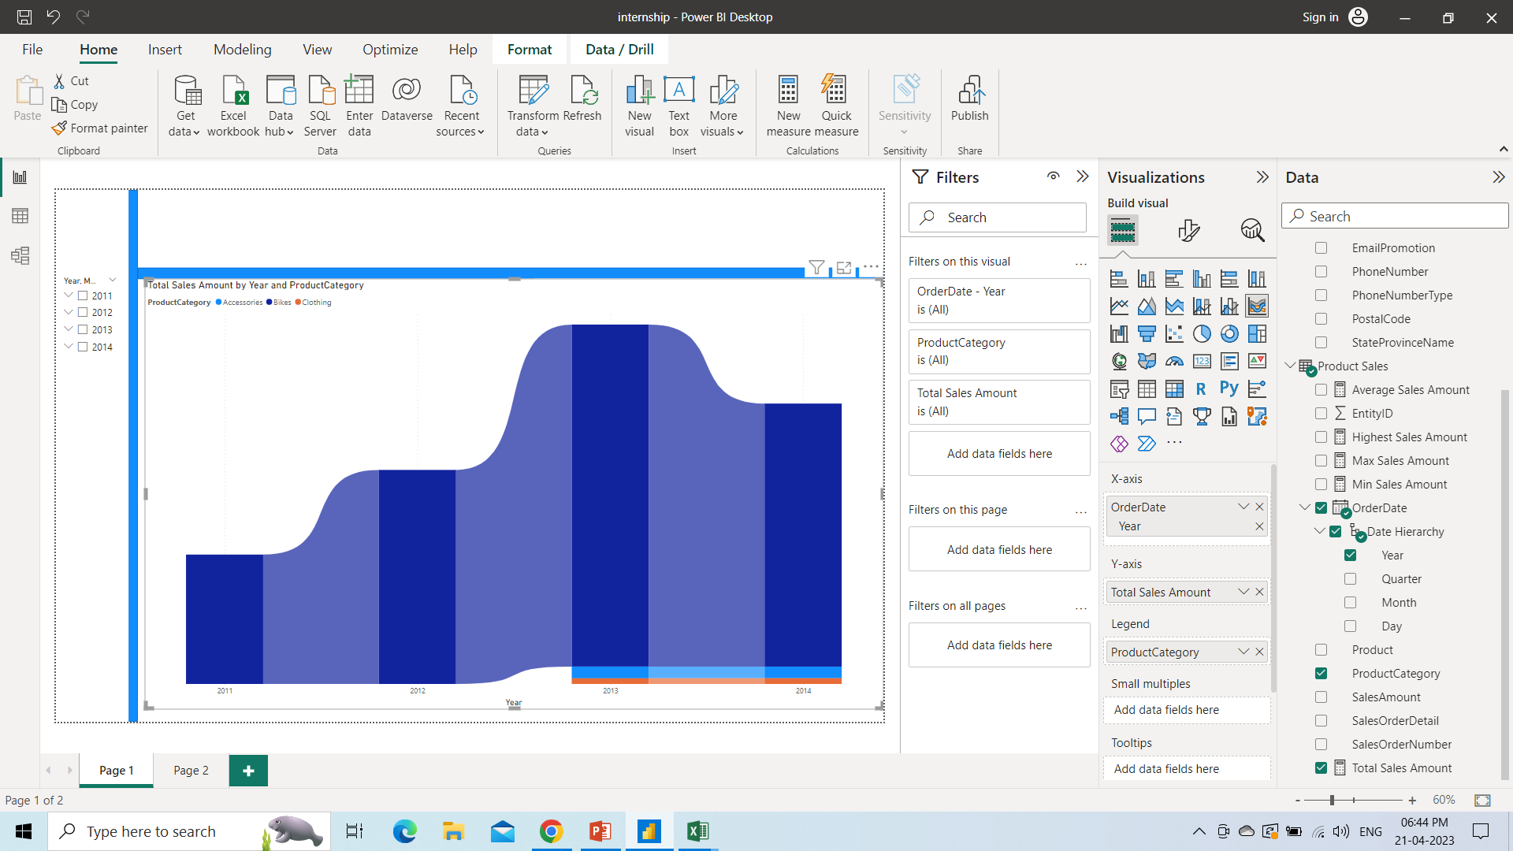
7. Which product category is having the highest sales?
Bikes in the year 2013 have the highest sales. Although every year bikes have the highest sales compared to other product category.

Slide 18
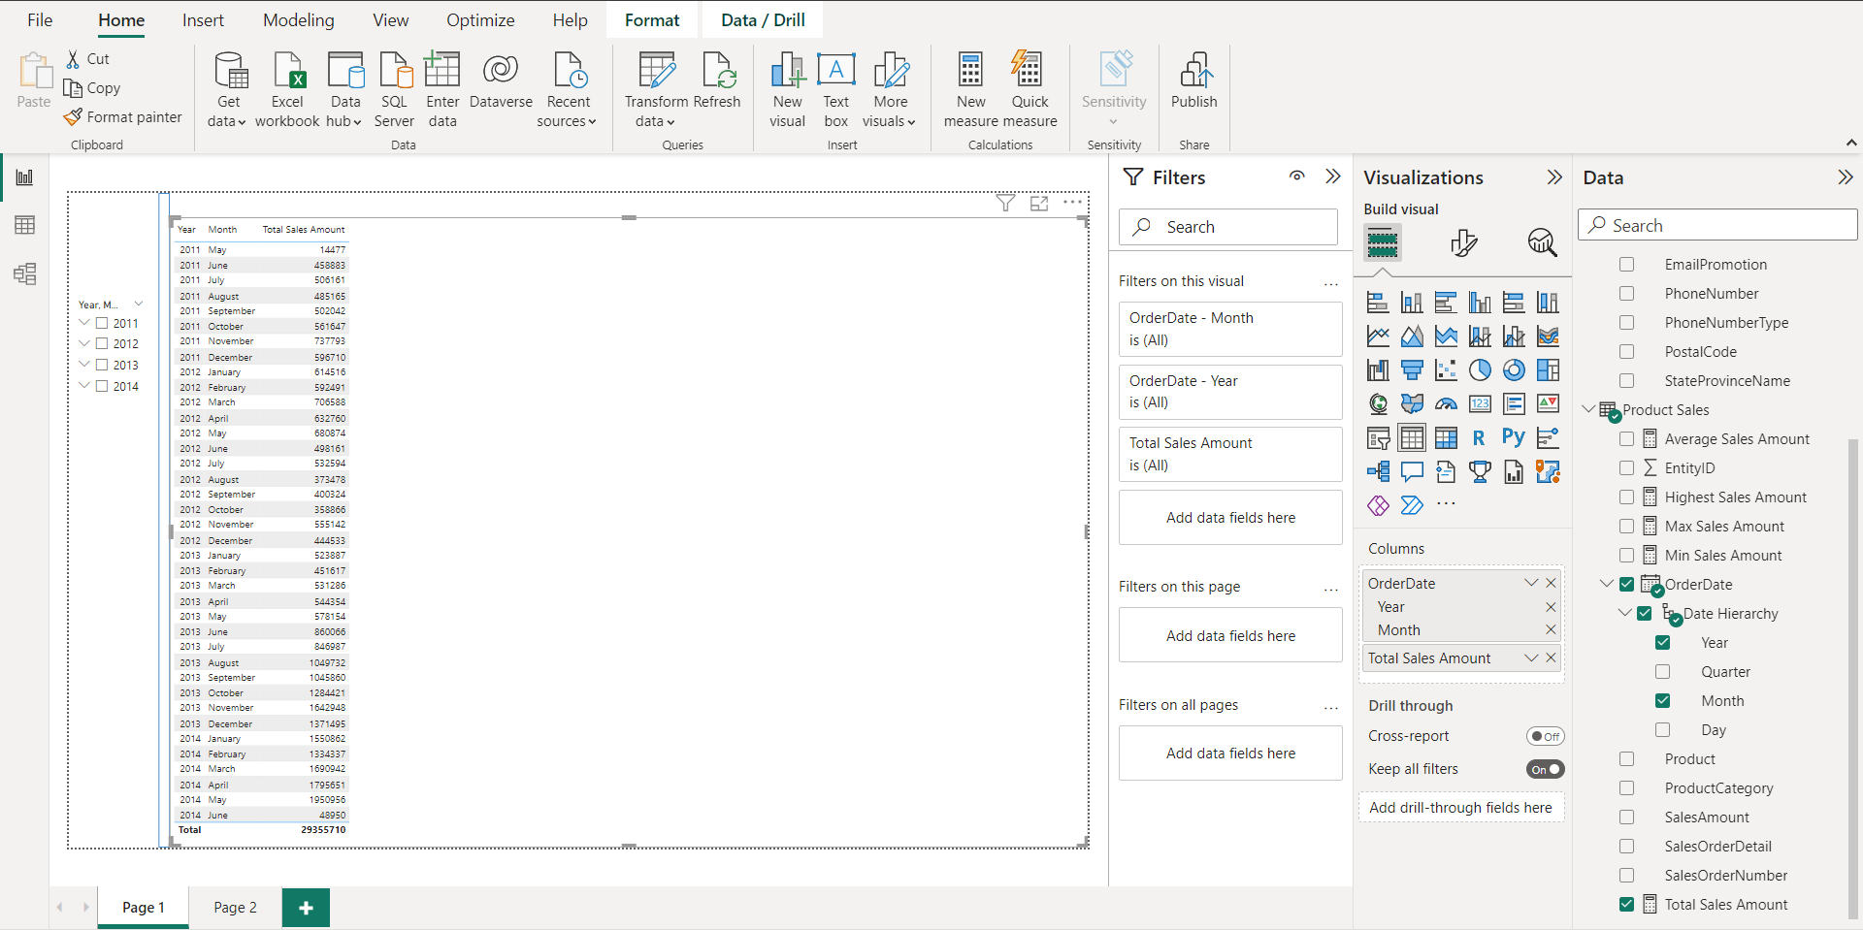
8. Show month over month Sales Amount.

Slide 19
Thank You
By Camellia Pramanik

